Slide 1


Semantic-Aware Loss Recovery for
Cross-Datacenter Model Training
Xingjian Zhang, Yutong Zhao, Jiaxue Liu, Lizhuang Tan, Shangguang Wang, Yiran Zhang
Beijing University of Posts and Telecommunications · Shandong Computer Science Center (NSCC Jinan)
The 10th Asia-Pacific Workshop on Networking (APNet '26)
August 6-7, 2026 · Singapore
Notes:
[Target timing: 0:00-0:20]
Good morning. I am Yiran Zhang from Beijing University of Posts and Telecommunications. This work asks a simple question: when cross-datacenter model training loses packets, should the network recover every packet equally? SMART uses training semantics to spend reliability only where it matters.

Slide 2
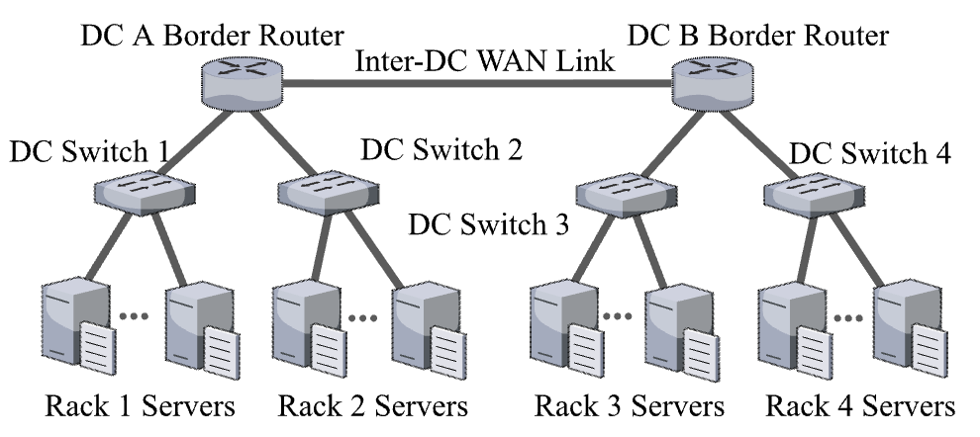
Model training in cross-datacenter
Cross-datacenter AI training pools scarce GPUs and balances compute and energy load
Parallel strategies in cross-datacenter scenario: pipeline parallelism, data parallelism
DP: transmits the entire model gradient, and the communication volume is huge but small frequency.
PP: transmits the activation value and gradient, the communication volume is small and moderate frequency.
The 10th Asia-Pacific Workshop on Networking (APNet '26), August 2026
Notes:
[Target timing: 0:20-0:50]
Cross-datacenter training pools scarce GPUs and balances compute and energy capacity across sites. In this setting, the two most practical cross-datacenter communication patterns are data parallelism and pipeline parallelism. DP sends model gradients with large volume but lower frequency, while PP sends activations and activation gradients with smaller volume but more frequent transfers.

Slide 3
Cross-datacenter scenario makes packet loss expensive
Cross-datacenter links have much longer propagation delay and non-negligible packet loss than intra-datacenter, making loss recovery necessary
DP gradients / PP activations
Datacenter A
Selective Repeat
Datacenter B
Waits for WAN-scale recovery round
long-haul WAN
Uniform FEC
Adds parity to every packet and consumes scarce WAN bandwidth
accelerators
accelerators
Both approaches are packet-centric and ignore how different training data affect convergence.
The 10th Asia-Pacific Workshop on Networking (APNet '26), August 2026
2
Notes:
[Target timing: 0:50-1:35]
Once training traffic leaves the datacenter fabric, loss recovery becomes expensive. Cross-datacenter links have longer propagation delay and non-negligible packet loss. Selective Repeat can recover lost packets, but each loss may wait for another WAN-scale recovery round. Uniform FEC avoids waiting, but it adds parity to every packet and consumes scarce inter-datacenter bandwidth. Both are packet-centric and ignore how different training data affect convergence.

Slide 4
Training traffic is not homogeneous
Top-K
critical
Large gradients
≈ 0.4% tolerable loss
Small gradients
> 20% tolerable loss
Uniform protection over-protects the long tail of small gradients
packet mean |gradient|
DP tolerance numbers follow MLT [NSDI 2024]
Data Parallelism (DP): importance varies with gradient magnitude
The 10th Asia-Pacific Workshop on Networking (APNet '26), August 2026
3
Notes:
[Target timing: 1:35-2:00]
The first observation is about DP gradients. Their importance is highly uneven. If we score each packet by the mean absolute gradient magnitude, only a small fraction carries the largest update signal. Prior measurements show that small gradients can tolerate more than twenty percent loss, while large gradients tolerate only about zero point four percent under similar convergence behavior. So uniform protection over-protects the long tail of small gradients.

Slide 5
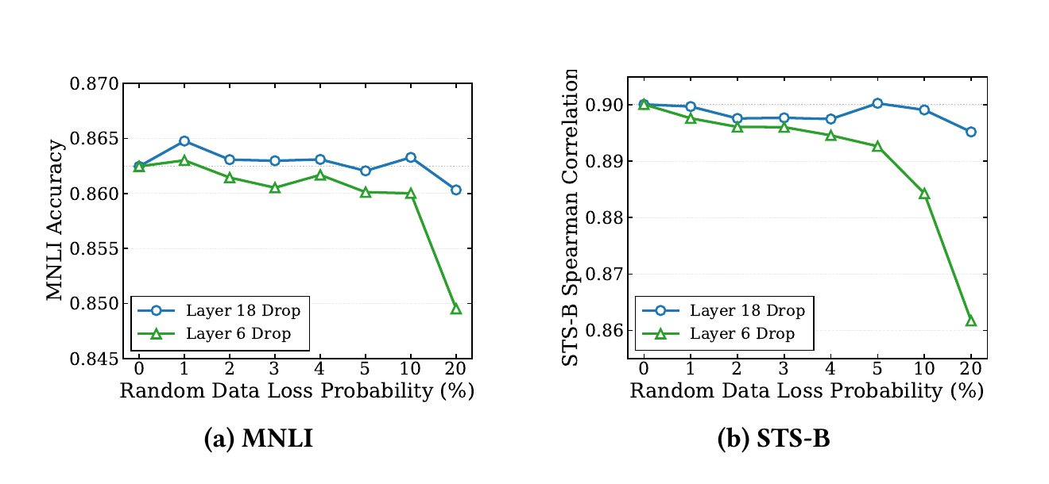
Training traffic is not homogeneous
Observation: Layer 6 drops degrade earlier and more sharply than Layer 18 drops.
Stage 1
later boundary: relatively more tolerant
Stage 2
Stage 3
earlier boundary: more sensitive
Stage 4
Pipeline Parallelism (PP): sensitivity varies with pipeline depth
The 10th Asia-Pacific Workshop on Networking (APNet '26), August 2026
3
Notes:
[Target timing: 2:00-2:25]
The second observation is about PP activations. Activations are more sensitive than DP gradients, but this sensitivity changes with pipeline depth. In our BERT-Large experiment, dropping activation packets at Layer 6 degrades MNLI and STS-B earlier and more sharply than dropping at Layer 18. Earlier boundaries therefore deserve stronger protection than later ones.

Slide 6
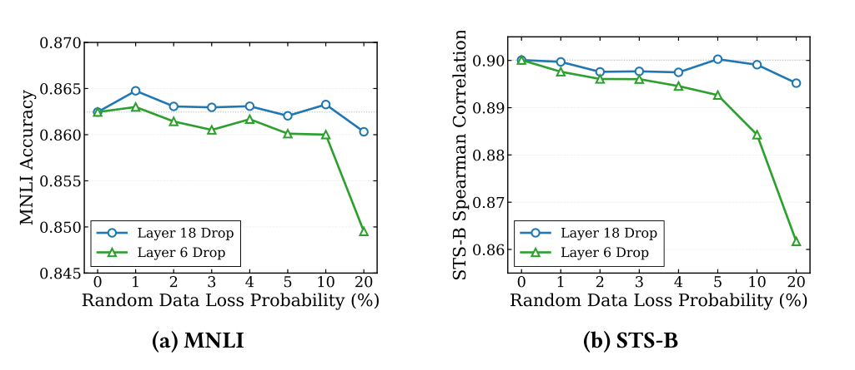
Training traffic is not homogeneous
Data Parallelism (DP): importance varies with gradient magnitude
Pipeline Parallelism (PP): sensitivity varies with pipeline depth
Top-K
critical
Stage 1
Stage 2
Stage 3
Stage 4
earlier boundary: more sensitive
later boundary: relatively more tolerant
packet mean |gradient|
Large gradients
≈ 0.4% tolerable loss
Small gradients
> 20% tolerable loss
Uniform protection over-protects the long tail of small gradients
Layer 6 drops degrade earlier and more sharply than Layer 18 drops
The 10th Asia-Pacific Workshop on Networking (APNet '26), August 2026
3
Notes:
[Target timing: 2:25-2:50]
Putting these two observations together, training traffic is not homogeneous. DP importance depends on gradient magnitude, while PP sensitivity depends on depth. A single packet-level reliability target is therefore mismatched: it wastes repair bandwidth on insensitive traffic and may under-protect critical traffic.

Slide 7
Can loss recovery exploit training semantics
instead of protecting every packet uniformly?
The 10th Asia-Pacific Workshop on Networking (APNet '26), August 2026
4
Notes:
[Target timing: 2:50-3:05]
This leads to the central question: can RDMA loss recovery exploit training semantics instead of protecting every packet uniformly? Our answer is SMART, a semantic-aware recovery layer for cross-datacenter model training.

Slide 8
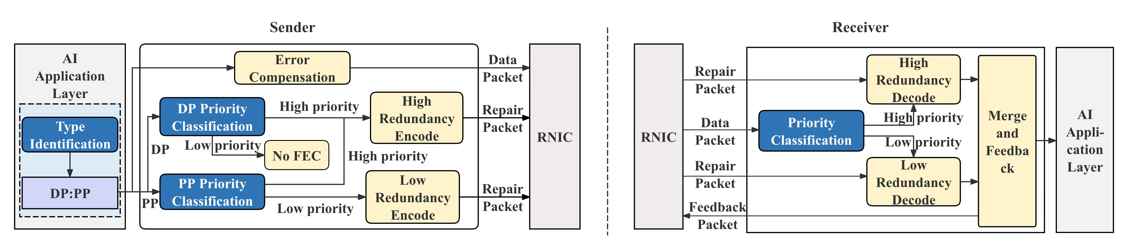
SMART: semantic-aware loss recovery
Message-level tags steer priority-aware FEC, bounded tolerance, and compensation
1 Priority Classification
2 Encode and Decode
3 Error Compensation
SMART identifies the traffic type and classifies packet priority
SMART allocates different redundancy for packet with different priority
SMART incorporates an error-compensation by sensitivity
Goal: training-level reliability with less repair traffic
The 10th Asia-Pacific Workshop on Networking (APNet '26), August 2026
5
Notes:
[Target timing: 3:05-3:50]
SMART sits below the application as a host-side semantic recovery layer. The sender first identifies whether a message carries DP gradients or PP activations. It then classifies priority using magnitude for DP and depth for PP. Priority decides the FEC redundancy and receiver action. When tolerated DP loss remains, the receiver sends lightweight feedback so the sender can compensate it in later iterations. The goal is training-level reliability with less repair traffic.

Slide 9
DP: classify high-priority and low-priority gradients
Priority classification
Selective FEC
Receiver action
Error compensation
μ(p) = mean |g|
τ ≈ sampled top-K cutoff
(default K = 1%)
HP → interleaved XOR FEC
HP: recover or retransmit
LP: zero-fill + bitmap
pₜ = xₜ + eₜ
missing LP values become eₜ₊₁
and are added next iteration
LP → no FEC
Priority rule: magnitude decides protection
HP if μ(p) ≥ τ
protect with FEC
DP gradient packet p
Score packet
μ(p)=mean |g|
Estimate threshold τ
from sampled Top-K
(default K=1%)
LP if μ(p) < τ
no FEC by default
payload values; taller bars have larger |g|
packet-level importance
small sample avoids full-tensor scan
Spend FEC redundancy on rare high-magnitude packets
The 10th Asia-Pacific Workshop on Networking (APNet '26), August 2026
6
Notes:
[Target timing: 3:50-4:35]
Now I break the DP design into two slides. First, priority classification. For each DP gradient packet, SMART computes the mean absolute gradient magnitude, denoted mu of p. It estimates a threshold tau from a small uniform sample using a top-K cutoff; by default K is one percent. If the packet score is above tau, it is high priority and enters FEC. Otherwise it is low priority and carries no FEC by default. This makes protection packet-level and importance-aware.

Slide 10
DP: protect only high-priority gradients
Priority classification
Selective FEC
Receiver action
Error compensation
μ(p) = mean |g|
τ ≈ sampled top-K cutoff
(default K = 1%)
HP → interleaved XOR FEC
HP: recover or retransmit
LP: zero-fill + bitmap
pₜ = xₜ + eₜ
missing LP values become eₜ₊₁
and are added next iteration
LP → no FEC
Iteration t
Iteration t+1
xₜ₊₁ + eₜ₊₁
0
0
LP loss
sender payload
receiver delivers zeros
residual is reinjected
feedback bitmap identifies unrecovered LP positions
Only the top 1% gradient packets protected by FEC
Tolerated LP loss is corrected by error compensation
The 10th Asia-Pacific Workshop on Networking (APNet '26), August 2026
6
Notes:
[Target timing: 4:35-5:20]
Second, error compensation handles the low-priority packets that are intentionally tolerated. At iteration t, the sender transmits a corrected payload p_t, which is the current gradient plus the error memory. If a low-priority packet is lost, the receiver zero-fills it and sends back only a bitmap of the missing positions. The sender then stores the corresponding residual in e_{t+1} and adds it to the next transmission. In this way, tolerated loss is corrected over time instead of becoming a systematic optimization bias.

Slide 11
PP: earlier boundaries receive stronger protection
Evidence: activation loss sensitivity depends on pipeline depth
SMART policy
L1
L2
L3
L4
L5
L6
early → late
Early boundary (HP)
Higher redundancy
Stricter residual-loss bound
Later boundary (LP)
Lower redundancy
Slightly looser but small bound
earlier split (Layer 6) degrades sooner
Residual ≤ bound: zero-fill and deliver
Residual > bound: retransmit
PP has nonzero but bounded loss tolerance
the bound should be conservative
All PP activations remain FEC-protected and tolerance is bounded
The 10th Asia-Pacific Workshop on Networking (APNet '26), August 2026
8
Notes:
[Target timing: 5:20-6:05]
For PP, SMART is more conservative because missing activations directly affect subsequent computation. SMART maps pipeline depth to priority. Earlier boundaries receive higher redundancy and a stricter residual-loss bound; later boundaries use lower redundancy and a slightly looser, but still small, bound. At the receiver, residual loss within the profiled bound can be zero-filled, while a larger residual triggers retransmission. Thus all PP activations remain FEC-protected and tolerance is explicitly bounded.

Slide 12
Evaluation
400 Gbps inter-DC link · 400 μs propagation
DC A
DC B
packet loss injected only here
Each DC: k=4 Fat-tree, 16 servers, 100 Gbps / 1 μs intra-DC links
Workloads
Baselines
Network loss
Metrics
•
Qwen3-3B-derived traffic
•
Selective Repeat (SR)
•
0%-5% inter-DC error rate
•
Average and P99 FCT
2-stage cross-DC PP
•
Intra-DC links are loss-free
•
Tail latency matters for synchronous steps
•
•
LoWAR(100,10): uniform FEC
•
32-way DP (AllGather + ReduceScatter)
•
Same packetization / XOR basis
•
Separate WikiText-2 convergence study
Evaluation platform: simAI
The 10th Asia-Pacific Workshop on Networking (APNet '26), August 2026
9
Notes:
[Target timing: 6:05-6:45]
We evaluate SMART in SimAI with two interconnected datacenters. Each site has sixteen servers in a k-equals-four fat-tree. The inter-datacenter link is four hundred gigabits per second with four hundred microseconds propagation delay, and packet loss is injected only on this link. The workloads are derived from Qwen3-3B training, using two-stage PP and thirty-two-way DP. We compare against Selective Repeat and LoWAR with uniform ten-percent parity, and report average and P99 flow completion time.

Slide 13
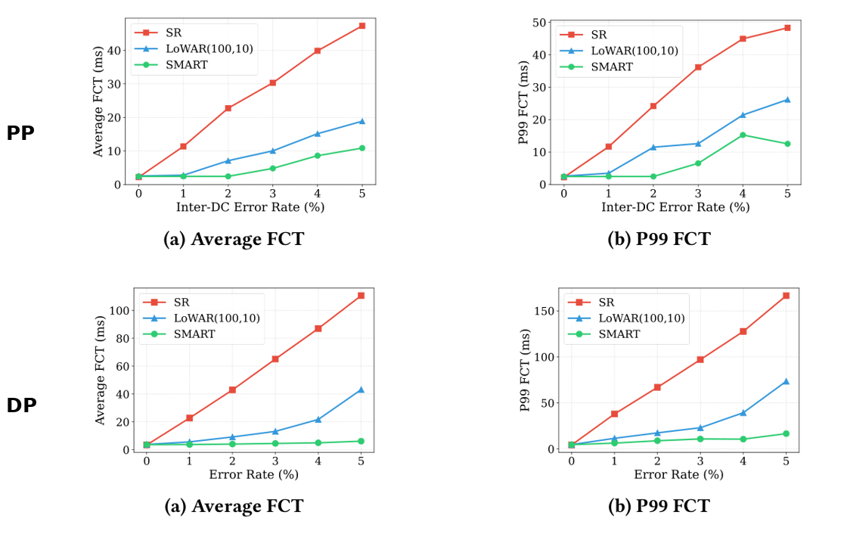
SMART consistently lowers average and tail FCT
P99 FCT reduction
up to 89.9% vs SR
up to 78.8% vs LoWAR
PP traffic
up to 91.7% vs SR
up to 73.0% vs LoWAR
DP traffic
Why SMART wins
✓
Avoids ms-scale retransmission
✓
Targets parity to important traffic
✓
Lowers Avg / P99 FCT
At near-zero loss, all schemes have little recovery work, so the gap is small
The 10th Asia-Pacific Workshop on Networking (APNet '26), August 2026
10
Notes:
[Target timing: 6:45-8:00]
Across all tested error rates, SMART gives the lowest average and P99 FCT for both PP and DP. For PP, the maximum P99 reduction is eighty-nine point nine percent over Selective Repeat and seventy-eight point eight percent over LoWAR. For DP, the corresponding reductions are ninety-one point seven and seventy-three percent. The gain over Selective Repeat comes from avoiding WAN-scale retransmission delay. The gain over LoWAR shows that uniform redundancy is inefficient when traffic has heterogeneous training importance.

Slide 14
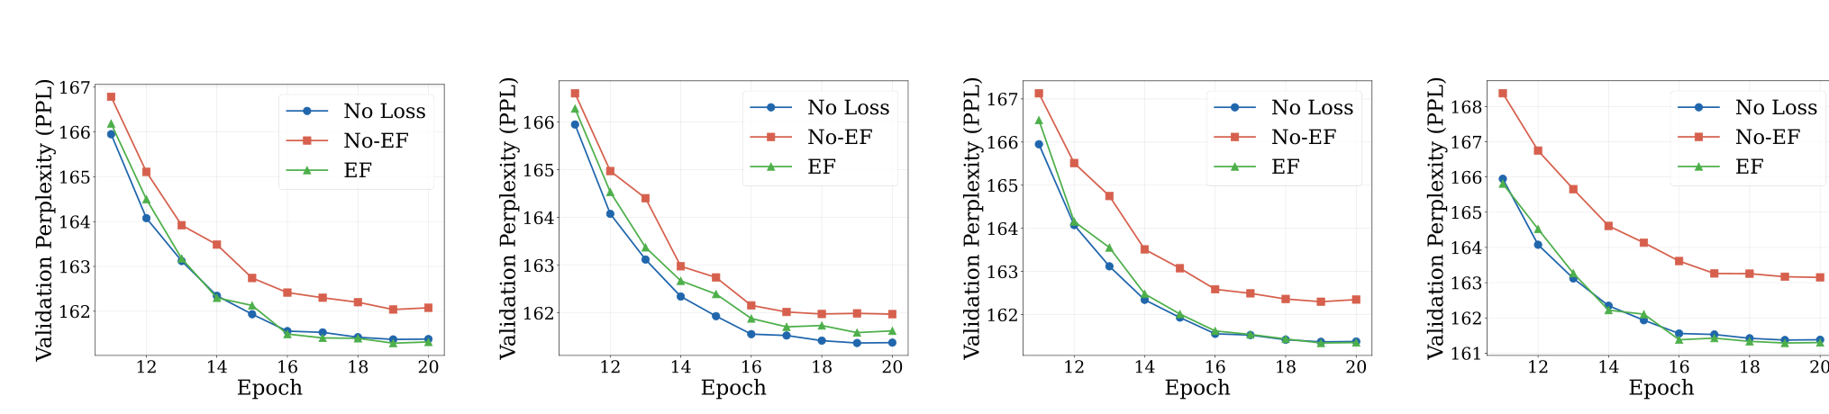
Error compensation preserves model convergence
Validation PPL (Perplexity) on WikiText-2 (lower is better)
Without error compensation
With error compensation
At 5% loss
No-EF converges to a worse plateau as tolerated LP loss increases.
No-EF: 163.15
EF: 161.29
EF stays close to the no-loss baseline from 0.5% to 5% loss.
The 10th Asia-Pacific Workshop on Networking (APNet '26), August 2026
11
Notes:
[Target timing: 8:00-9:05]
The remaining question is whether tolerated DP loss harms optimization. We study this on WikiText-2. Without error feedback, the model converges to a worse validation-perplexity plateau, and the gap grows with loss rate. With error feedback, the curve stays close to the no-loss baseline from zero point five to five percent loss. At five percent, No-EF ends at one hundred sixty-three point one five, while EF reaches one hundred sixty-one point two nine. This shows that the main issue is not bounded low-priority loss itself, but leaving its residual uncompensated.

Slide 15
Conclusions
✓
SMART makes cross-datacenter loss recovery training-aware using lightweight message-level semantics.
✓
SMART protects large DP gradients and early PP activations more strongly, while tolerating only bounded residual loss.
SMART reduces average and P99 FCT and error compensation keeps convergence close to the no-loss baseline.
✓
Thank you!
The 10th Asia-Pacific Workshop on Networking (APNet '26), August 2026
12
Notes:
[Target timing: 9:05-10:00]
To conclude, SMART makes cross-datacenter loss recovery training-aware using lightweight message-level semantics. It protects large DP gradients and early PP activations more strongly, while allowing only bounded residual loss. This semantic allocation lowers both average and tail flow completion time, and error compensation keeps convergence close to the no-loss baseline. Our current evaluation is simulation-based and targets transient inter-datacenter loss; SMART should be viewed as a recovery layer, not a replacement for WAN congestion control. Thank you.

